Slide 1

LSBU Tech
Musa Bhola: 4110867
Yameen Munir: 4214293
Anastasia Tolmacheva: 4201103
Lorena Matos: 4300895
Professional practice
05/03/2024

Slide 2

Problems
Aims Create a feature that will allow...
Students to provide anonymous feedback.
Students don’t have the ability to provide feedback for lessons.
Teachers to have access to the honest feedback.
Teachers don't have clear feedback about their lessons.

Slide 3
Objectives
Improving teaching strategies
Influence lessons
Teachers
Students
Textual feedback to lessons
Textual feedback
Graphical representation of feedback
Quick feedback
Solve problems at an early stage​

Slide 4

Solutions Approach
Design & User Experience:
Creating an attractive and intuitive interface considering the diverse LSBU audience.
Rapid prototyping through an iterative process, incorporating feedback from the team and users.
Alternative Products Research:
Analyzing existing feedback solutions, identifying their strengths and weaknesses.
Exploring opportunities for unique features within the LSBU system.
Persona Development:
Investigating the needs and characteristics of LSBU students and administrative staff.
Creating detailed user profiles to tailor the system to their requirements.
Frontend Technologies:
Choosing modern frontend technologies that will provide responsive design and cross-browser compatibility.
Backend Technologies:
Selecting scalable and secure technologies for handling large data volumes and ensuring confidentiality.

Slide 5
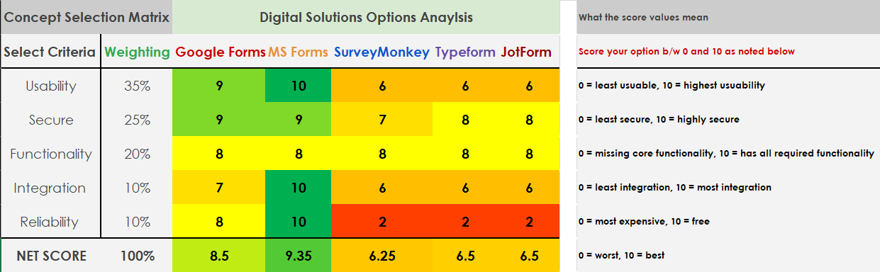
Options analysis

Slide 6
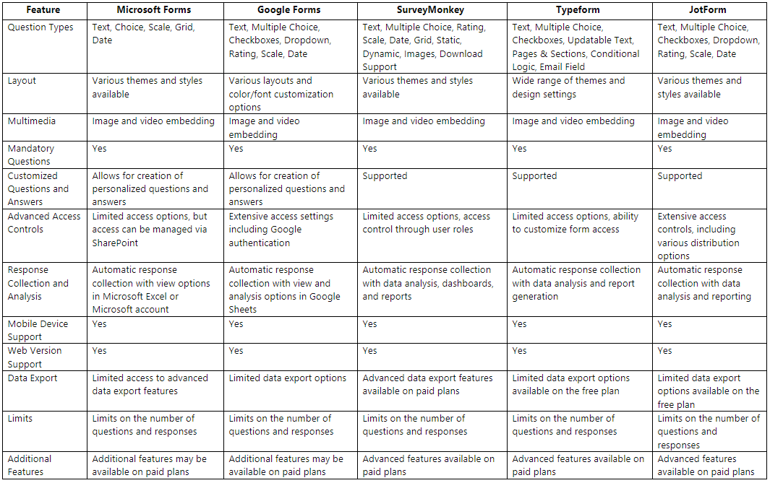
Detailed Options Analysis

Slide 7
ALTERNATIVE PRODUCTS
OUR PRODUCTS
JotForm
Typeform
Google Forms
SurveyMonkey
Microsoft Forms
Mobile Device Support
Mandatory
Questions
Response
Collection and Analysis
Access Controls
Web Version Support
Optional
Questions
Data Export
Different Question Types
Friendly style
Confidentiality
Access only for LSBU students

Slide 8
List of Frontend technologies
Ember
Reacts.js
Vue.js
Angular
Svelte
LIST OF BACKEND TECHNOLOGIES
Node.js
Laravel
Rust
ASP.net
Django
Flask
Spring Boot
According to research from: (Desai, 2023)

Slide 9
Node.js
Node.js is an ideal backend technology as it features scalability for network applications.
Advantages of Node.js include:
Useful for both frontend and backend development
Encourages sharing of code which reduces the need to switch between software’s for frontend and backend.
Rich package ecosystem which gives developers a range of prebuilt modules and packages to use.
Disadvantages of Node.js include:
It may limit CPU performance when doing intensive tasks.
It has a steep learning curve for beginners. Developers may need time to grasp the various components and understand how they interact.
According to research from: (GeeksforGeeks, 2023) and According to research: (Anon, 2024)

Slide 10
Data Privacy and Security
Prioritizing data privacy and security
Having data protection regulations such as end-to-end encryption and secure communication protocols helps build user trust.
Demonstrates commitment to safeguarding sensitive data, preventing unauthorized access, and upholding the confidentiality of user interactions.
Node.js
Single-threaded – Can handle multiple client requests, reducing the risks of the LSBU app from crashing.
We have decided to use Node.js since it can run on different operating systems, which would provide flexibility during development.
Ensure that the feature on the MyLSBU app can be run on different operating systems as needed.
Node.js is compatible with the major web browsers

Slide 11

User persona profile: Susan
Role: Full-time undergraduate student studying Chemical engineering
Needs:
A feature where she can provide feedback for her lecturers.
Give suggestions regarding how to make it more engaging?
Preferences:
Mobile friendly UI
Having access on both Mobile and Desktop.
Challenges:
Not being able to provide feedback
Feedback may not be seen

Slide 12


User Persona profile: Dr Who
User Persona profile: Steve Smith
Role: Course Leader
Needs:
Access overall lecture feedback
Access teacher feedback from students
Preferences:
Filtered feedback
Friendly UI
Feedback History removed after a preferred time
Download feedback data
Challenges:
Unaware of the delivery of the course
Role: Senior lecturer for the computer science
Needs:
Access to the student’s feedback data
Encourage student participation
Preferences:
User-friendly interface
Filtered feedback
Access to graphical data
Set timely notifications based on his preference
Challenges:
Student engagement declining
Hard to engage students

Slide 13
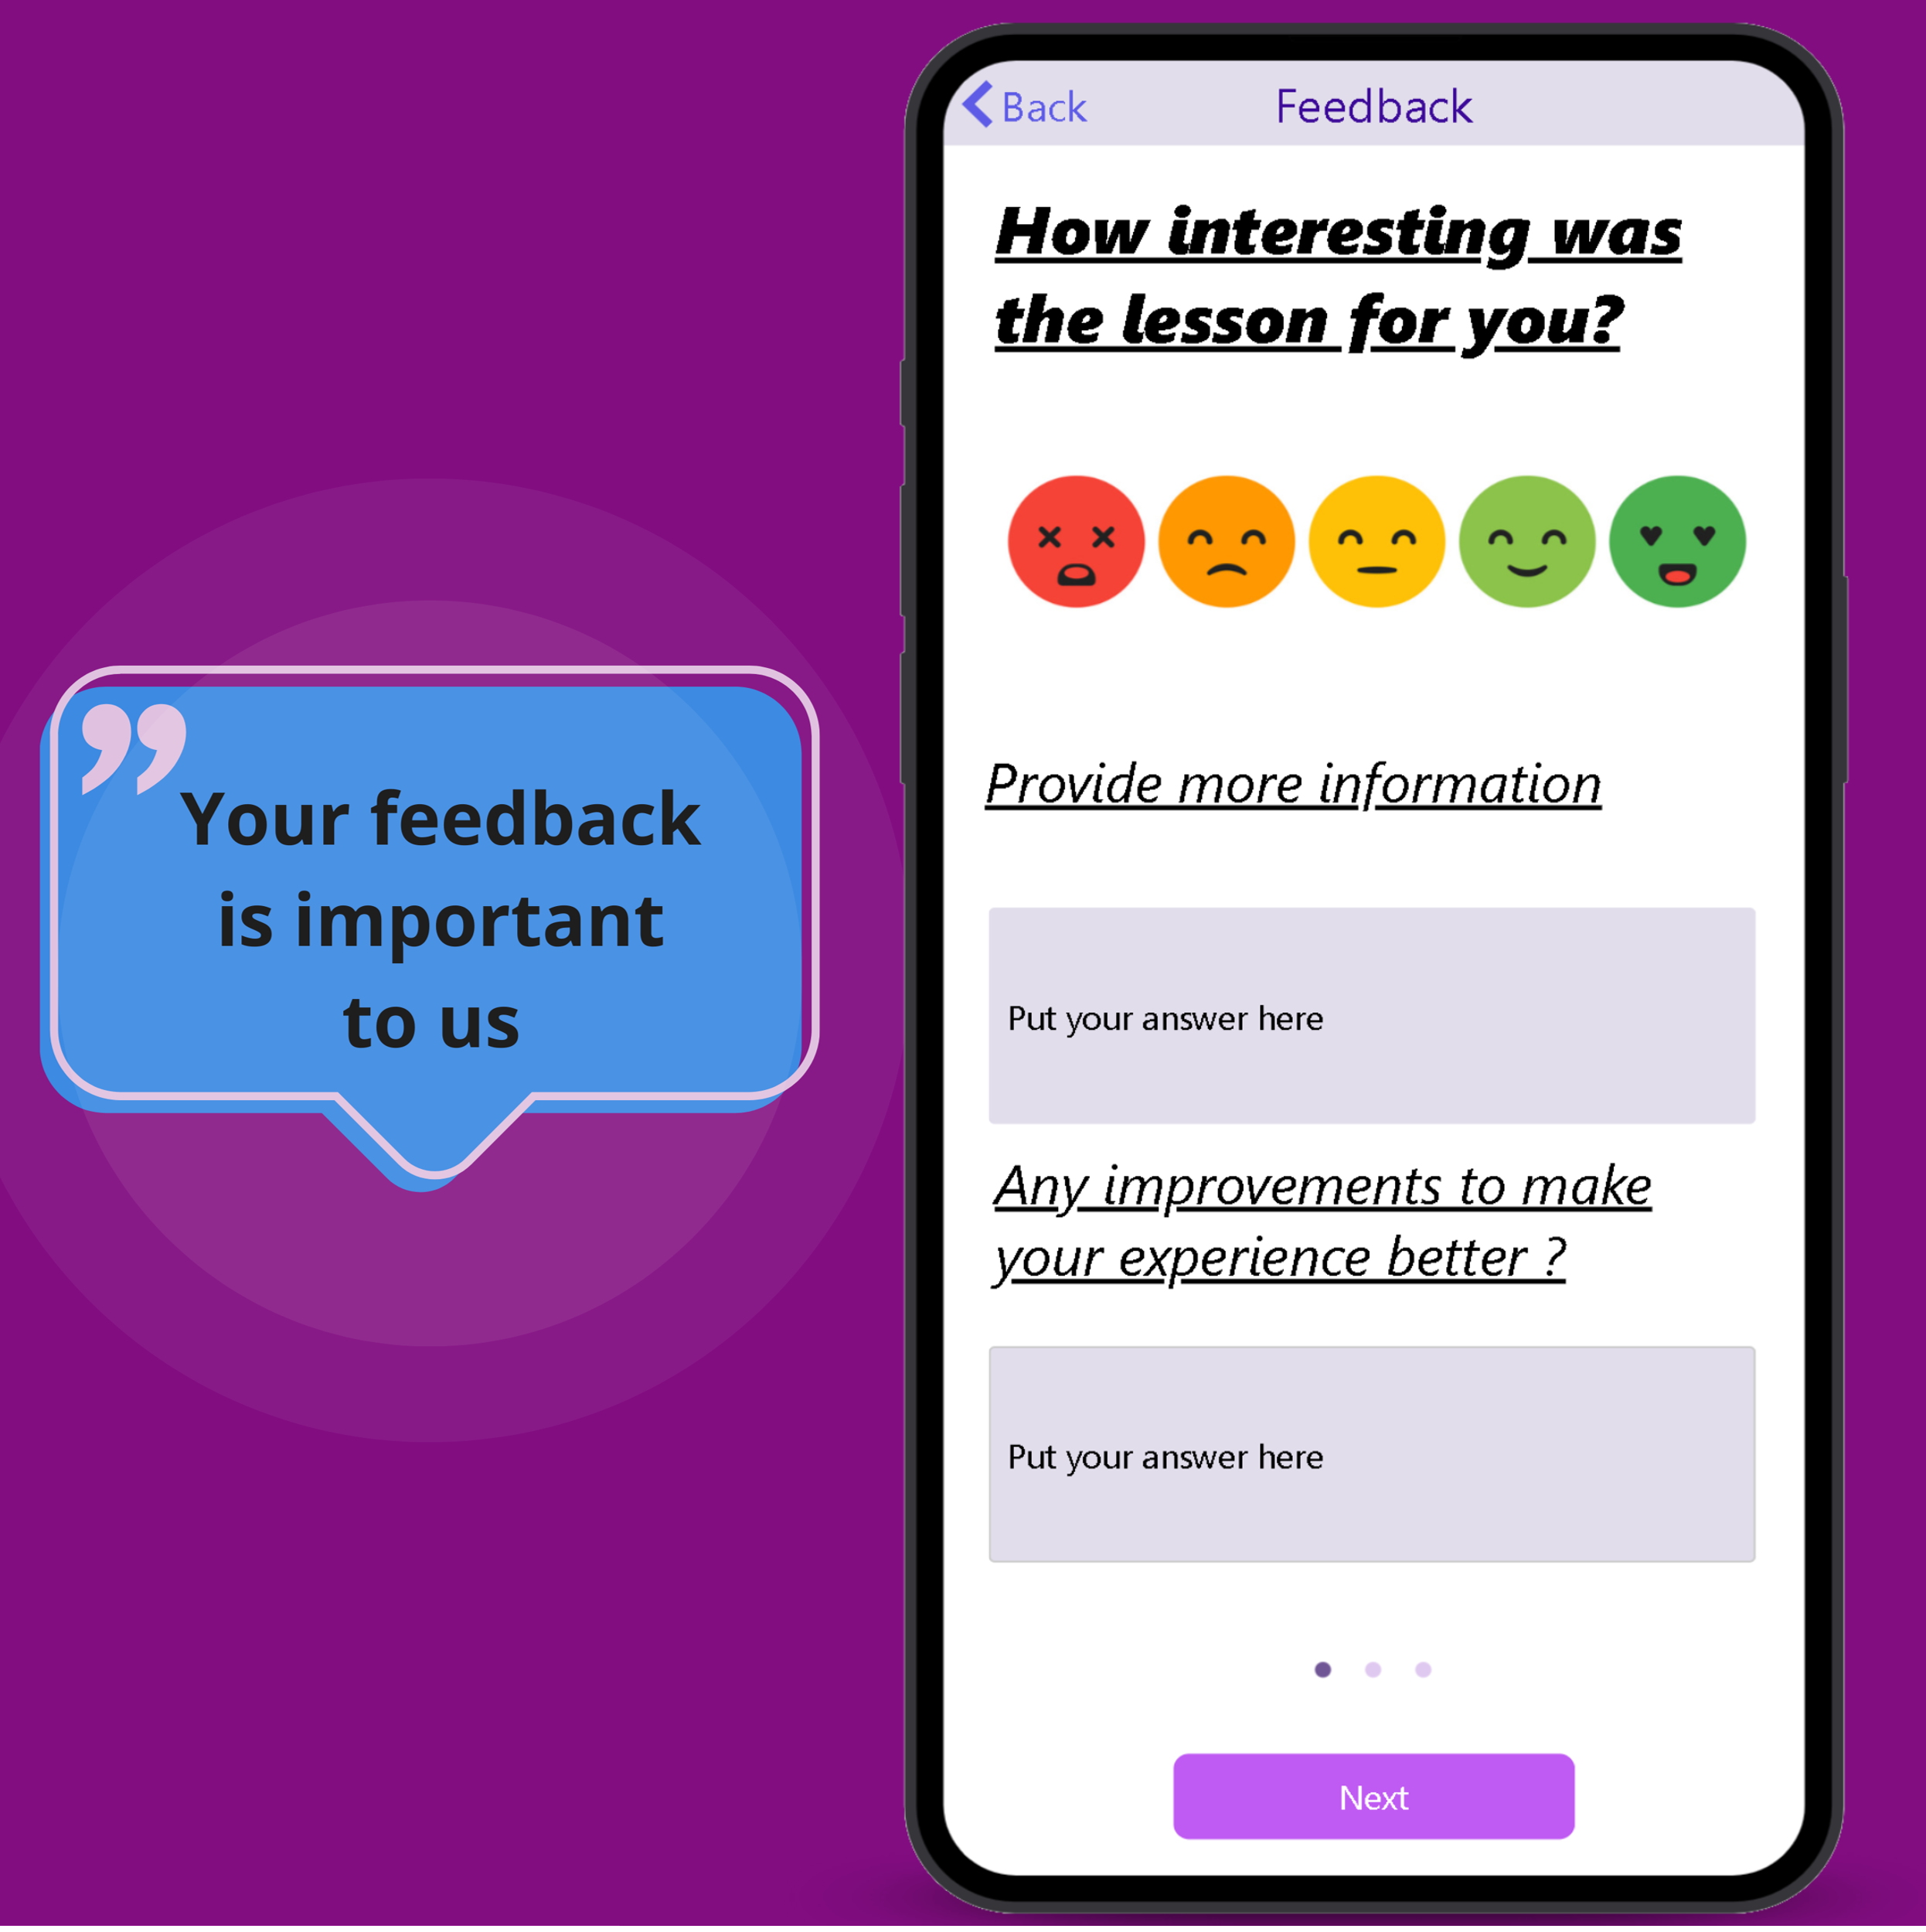
Product Features "LSBU Project Contribution Evaluation System"
Feature within the “MyLSBU” app
User friendly interface
Minimalistic design
Pulse survey
Allowing the user to provide more details regarding their feedback

Slide 14
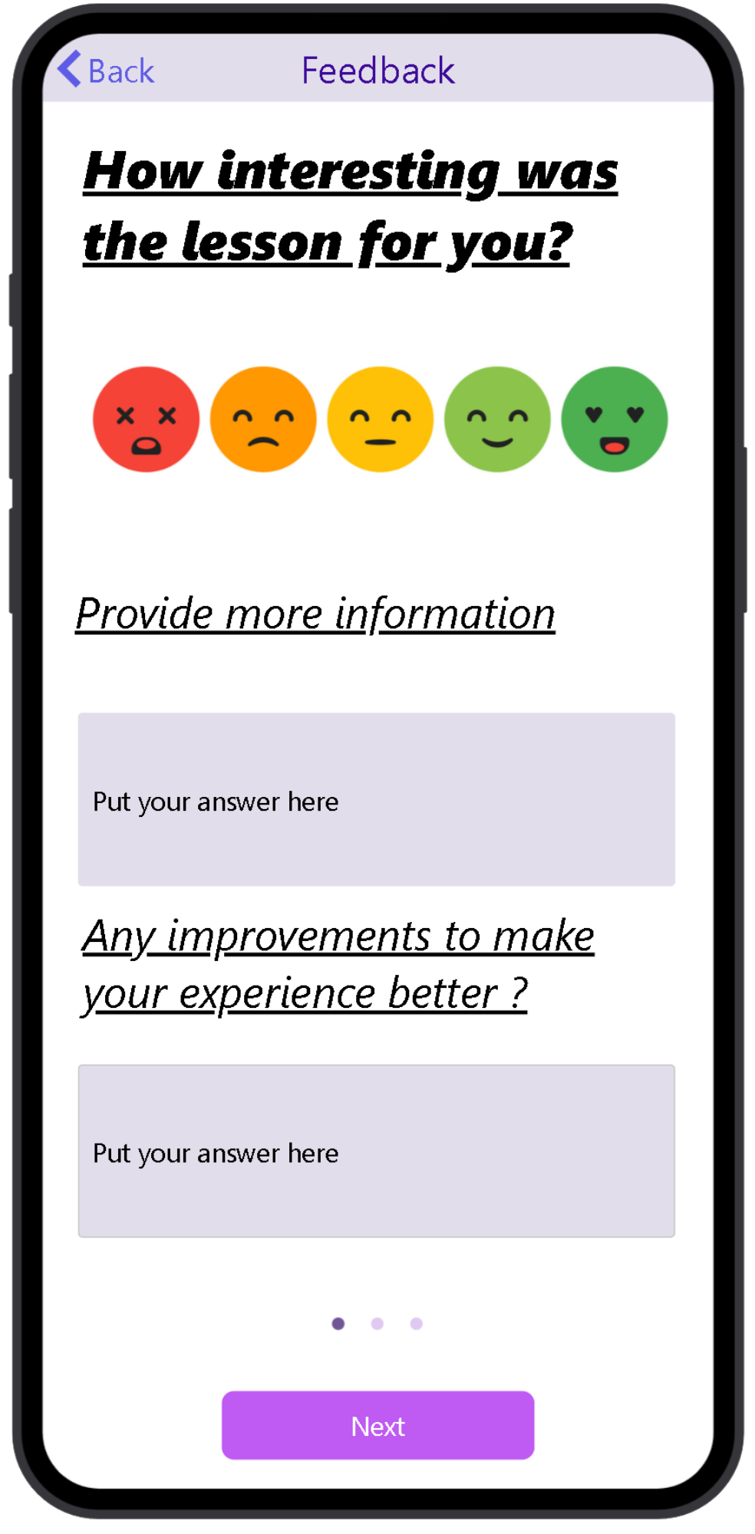
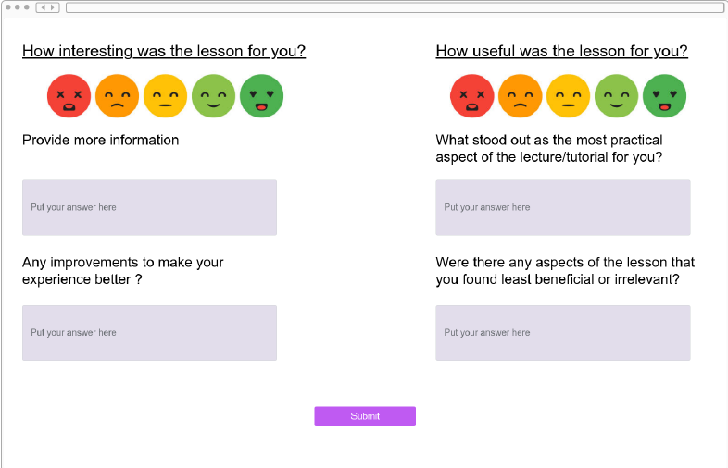
UI Design
https://youtube.com/shorts/mJ1Ksklk44M - Mobile UI
https://youtu.be/Daakju1_844 - Desktop UI
Proto.io – Used for Designing UI designs

Slide 15

Roles
Design & User Experience Lead - Everyone
Persona Developer Lead – Musa Bhola, Anastasia Tolmacheva, Yameen Munir
Frontend Technology Lead - Lorena Matos, Yameen Munir
Backend Design Engineer - Musa Bhola, Anastasia Tolmacheva
Alternative Products Researcher - Musa Bhola, Anastasia Tolmacheva

Slide 16
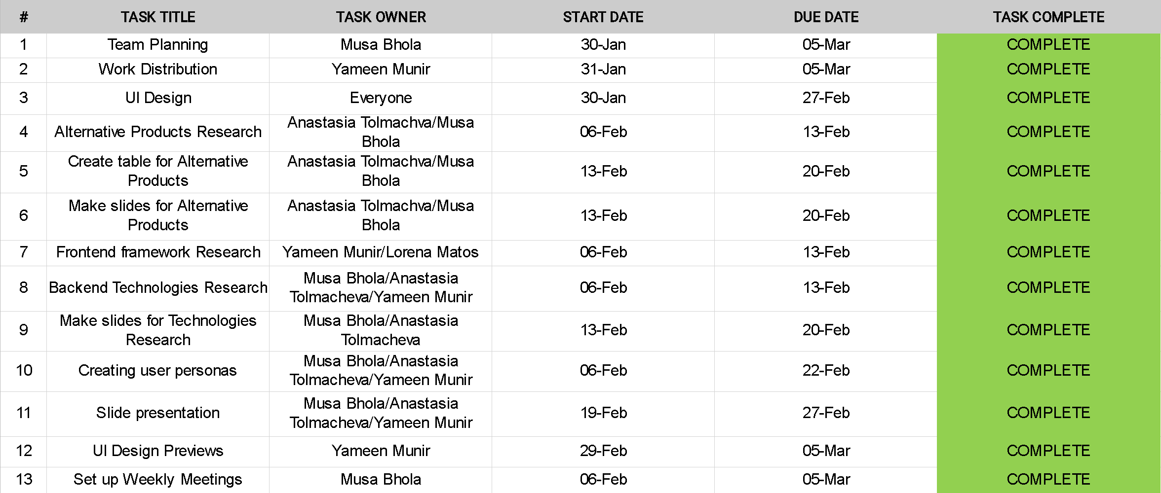
Project Plan

Slide 17


Issues/Benefits of the work
Benefits of us working as a team:
Reduced stress
Increased productivity
Increased quality
Skill development
Work was done quickly
Multiple forms of communication (Teams and WhatsApp)
Issues of us working as a team:
Becoming reliant on one another
Decision making delays
Time management
Difficulty in coordination

Slide 18
Reference Page:
Anon, (2024). 7 Top Backend Technologies 2024 with pros and cons - Alpha Code. [online] Available at: https://alphacode.dev/backend/top-backend-technologies-2024/ [Accessed 20 Feb. 2024].
Desai, J. (2023). 5 Best Frontend Frameworks for Web Development in 2024. [online] Positiwise. Available at: https://positiwise.com/blog/best-front-end-frameworks#Pros_of_React [Accessed 15 Feb. 2024].
GeeksforGeeks. (2023). How to Choose the Right Backend Technology? [online] Available at: https://www.geeksforgeeks.org/how-to-choose-the-right-backend-technology/ [Accessed 12 Feb. 2024].
Proto.io – Used for Designing UI designs

Slide 19
THANK YOU FOR LISTENING!
Anastasia Tolmacheva: 4201103
Lorena Matos: 4300895
Musa Bhola: 4110867
Yameen Munir: 4214293
Professional practice
05/03/2024

